Slide 1
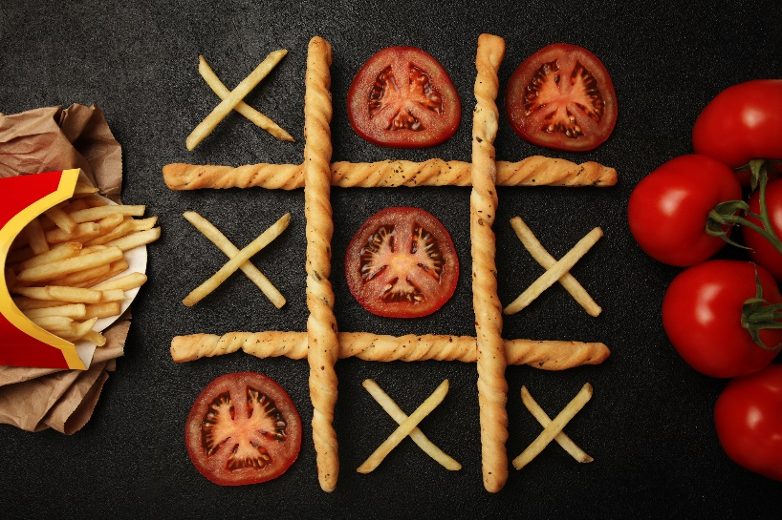
Tic Tac Toe Example
Functional Implementation
OO Implementation
Finding the Objects
Defining the API

Slide 2
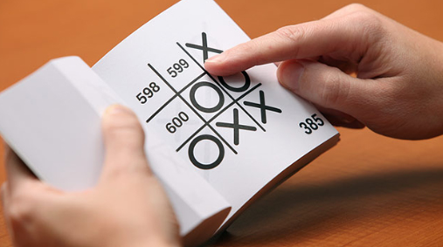
See Also
https://www.amazon.com/Tic-Tac-Autonomous-Playing-Book/dp/1594746877
https://towardsdatascience.com/tic-tac-toe-creating-unbeatable-ai-with-minimax-algorithm-8af9e52c1e7d
Notes:
Here is some additional reading about the web … on the web

Slide 3

What objects do you see?
Two Players
Computer, human, others?
Has a token
Hat
Tree
Grass
Timer
Tokens
Exactly 2 kinds
Shoes
Game Board
Cells
Exactly 9 cells
Starts empty
Rules about wins and tie
Relationship! Can have zero or one token
Can’t change during play
Notes:
OO is about modeling the problem with objects that interact with each other. This is a tic-tac-toe game in progress. What objects do you see and how do they interact?
#1 I see a game board. #2 The board keeps a collection of 9 cells. Somewhere in its code we’ll likely find the rules about wins and ties.
#3 There are the nine cells. Do we need objects for the cells? Or is this just a detail of the board itself. We don’t expect to find a cell without a board.
#4 I see two kinds of tokens. Is a token an object? What would we ask it to do?
#5 Two players. I bet we need those. Are they the same kind of object? (Here they are both human), but what about computer players?
#6 What else? Well, here’s a tree … and grass. Is the grass a collection of individual blades? I doubt we’ll need to model these in our game, but you might have captured them in your first round of design.
Objects you thought were obvious might turn out to be insignificant. And, as you code, you will uncover subtle objects that were hidden at first.
#7 Players have attributes. Gender? A hat? Shoes? Significant to our game here? Probably not … but maybe significant to player objects in other situations.
#8 How about a timer? Maybe our game is timed? If so, who keeps the time? A single player? Maybe that should its own object? Or maybe the timer is part of the board itself?

Slide 4
K.I.S.S
# Loop Until Game Over
# Ask player 1 for their move
# Put an X on the board there
# Check for win
# Check free space
# Ask player 2 for their move
# Put an O on the board there
# Check for win
# Check for free space
# Loop Forever
# Loop over 1 and 2
# Ask player N for their move
# Put token N on the board there
# Check for win
# Check for free space
# Loop Forever
# Loop over 1 and 2
# Ask player N for their move
# Put token N on the board there
# Check board status
Notes:
Hang on, Chris. This is just a tic-tac-toe game. No need to overthink it. Let’s keep it simple. We’ll look at an OO design shortly. It might surprise how much of the exact same thinking goes into both.
Let’s start with some pseudo code … in comments
#1 .. #4 walk through the steps.
#5 And the same steps for player two.
What about the check for tie? There can’t be a tie after player 2 (odd number of cells).
#6 But it doesn’t break if we do, and if we add it then the steps for both players are the same. #7
#8 OK. They aren’t exactly the same, but we can parameterize the differences and pass them into the block of code
#9 Like this. We pass the player and the token are independent of the code – not hard coded like before.
The code is less efficient. We waste time with a needless tie-check. We also waste time setting up a loop and pulling out the token and player (hard-coding is much faster) But we get SOFTWARE REUSE of code we’ve already written. Efficiency or Reuse? Fewer instructions mean less chance of mistakes. Easier to understand (think maintain). Is that worth the cost of runtime?
We also want our code to be as safe as possible. #10 Notice that the order of these checks is critical. The game can be a win without having an empty space, say if X wins on the last move.
#11 We can do some planning up front and avoid that gotcha completely!
#12 How about we check for win and tie with the same helper function. Afterall, both checks require looping over the entire board.

Slide 5
Information Types
C++
enum PLAYER {
PLAYER_1, PLAYER_2
};
int ask_for_move(bool is_player_1) {
return 0;
}
int ask_for_move(int player_num) {
return 0;
}
int ask_for_move(PLAYER player) {
return 0;
}
enum Player {
PLAYER_1,PLAYER_2
}
int ask_for_move(Player player) {
return 0;
}
Java
int move = ask_for_move(true);
int move = ask_for_move(Player.PLAYER_1);
int move = ask_for_move(1);
def ask_for_moveA(is_player_1):
pass
move = ask_for_moveA(True)
move = ask_for_moveA(is_player_1=True)
move = ask_for_moveA("player1")
move = ask_for_moveA(PLAYER_1)
Python
int move = ask_for_move(PLAYER_1);
Notes:
Speaking of “helper functions”, let’s go ahead and think about functions we’ll need. What arguments to they take? What do they return?
I’ll use C++ here since it forces us to think clearly about what the data is.
#1 We might have a function to prompt the players for their move. We pass in the player number and the function returns the player’s input. Let’s stub it out here for now.
What does “player number” mean? #2 is this X or O? Are we using 0 and 1 for player 1 and 2? Or just simply 1 and 2? Other code might use this function in the future. How do we explain this to the future developer? Comments? Definitely comments.
What if using code accidently passes in a 3? We could give an error at runtime. But it would be better to prevent the coder from making the mistake in the first place. We could let the compiler catch the mistake.
#3 There are only two players … two possibilities. Maybe BOOLEAN would make a good argument. It looks pretty good here at the function #4 but what about the caller. TRUE – is that player 1 or 2?
I think the best way is to create an enumeration #5 of the two choices. #6 Then the argument is of the enum type #7 which means the caller has to say PLAYER_1 or PLAYER_2 explicitly. The call is clear and there is no room for mistakes.
#8 Java has enums too. #9 the helper function looks the same, #10 but the caller has to type more. I still like this better – it is clear to me that this is a member of an enum and not a variable. This could be a variable.
#11 How about python? No enums there, but do have named arguments. #12 instead of just “what the heck is this” we can use the param name #13 like this.
#14 Usually we just use a string value #15 with a constant defined to that value. Looks like the C++ version, doesn’t it? The early Java classes had to use this string-and-constant technique – enums were added to the language after the AWT GUI library.

Slide 6
Functions
enum BOARD_STATUS {
PLAYING, TIE, WON_1, WON_2
};
int ask_for_move(int player_num) {
return 0;
}
void place_token(int cell_num, int player_num) {
}
int get_board_status() {
return -1; // Still going
return 0; // Tie
return 1; // Player 1 won
return 2; // Player 2 won
}
void print_board() {
}
C++
0 - 8
def get_board_status():
return 'playing'
return 'tie'
return 'won_1'
return WON_2
Python
Not a continuum
Notes:
#1 How about the return type. Is an integer correct here? #2 cells 0-8? Or 1-9? An enum of cell names feels clunky here. I suspect the code is going to treat this value as an index into an array of cells. It feels natural to map the cells to integers from left to right and top to bottom – 0 to 8.
#3 What about the board status? (#4, #5,#6,talk about these) This seems really confusing and error prone.
#7 Board status is NOT a continuum. I got back a -5 … what does that mean? #8 an enum is clearer in this case.
#9 Again, no enums in python. Python wasn’t meant for early-compile type-checking. I’d just use strings here ... Better defined in constants

Slide 7
Game Logic
playing = True
while playing:
for player in [1,2]:
move = ask_for_move(player)
place_token(move,player)
status = get_board_status()
if status == 'won_1':
print('Player 1 won')
playing = False
break
elif status == 'won_2':
print('Player 2 won')
playing = False
break
elif status == 'tie':
print('It is a tie')
playing = False
break
print_board()
Python
board = [0,0,0,0,0,0,0,0,0] # [0]*9
# 0=empty, 1=player1, 2=player2
def ask_for_move(player_num):
# Print the board to show status
# Read int from keyboard
# Error check input and cell
pass
def place_token(move,player_num):
board[move] = player_num
def get_board_status():
pass
def print_board():
print(board)
Python
Notes:
Now we can start filling in those functions and add the game logic.
#1 switching to python, our board is just a list of integers … 0,1,2
#2 Ask the player for a move … still some work to do here.
#3 placing a token on the board? That’s easy – given the index and the token. No error checking here yet, but you should add it later.
#4 Get the board status. #5 A function to visualize the board … not very elegant, but that’s where you come in later!
#6 Now the game logic. Let’s keep looping as long as the game is going.
#7 two players … loop over those. #8 get the move and place the token
#9 check the status. #10 #11 #12 #13 Report wins and ties … stop the outer loop and break out of the inner
#14 #15 for player 2 and tie
#16 And print the final board state on the way out
See? We don’t need that fancy OO stuff!
We DID spend a lot of time thinking about our functions and arguments, but there were no objects.

Slide 8
Reuse?
playing = True
while playing:
for player in [1,2]:
move = ask_for_move(player)
place_token(move,player)
status = get_board_status()
if status == 'won_1':
print('Player 1 won')
playing = False
break
elif status == 'won_2':
print('Player 2 won')
playing = False
break
elif status == 'tie':
print('It is a tie')
playing = False
break
print_board()
Python
Global – collisions?
board = [0,0,0,0,0,0,0,0,0] # [0]*9
# 0=empty, 1=player1, 2=player2
def ask_for_move(player_num):
# Print the board to show status
# Read int from keyboard
# Error check input and cell
pass
def place_token(move,player_num):
board[move] = player_num
def get_board_status():
pass
def print_board():
print(board)
Tightly coupled
Hardcoded to one global board
Notes:
How easy is our code to maintain … or reuse?
#1 We’ve got this global variable out here. If someone imports our code the wrong way they could get unexpected overwrites of their own variables.
#2 What if we want more than one board in the universe? Maybe a game server maintaining several games at once? All of our functions are hard-coded to exactly one board. No room for expansion.
#3 What if want to swap out players? Maybe different types of computer players? Our game logic is tightly coupled to this one implementation. There is no easy way to swap players in and out.

Slide 9
Evolution to Objects
board = [0,0,0,0,0,0,0,0,0]
def place_token(move,player_num):
board[move] = player_num
def get_board_status():
pass
def print_board():
print(board)
place_token(8, 1)
board = [0,0,0,0,0,0,0,0,0]
board2 = [0,0,0,0,0,0,0,0,0]
def place_token(brd,move,player_num):
brd[move] = player_num
def get_board_status(brd):
pass
def print_board(brd):
print(brd)
place_token(board, 8, 1)
place_token(board2, 5, 2)
Python
Python
class Board:
def __init__(self):
self.cells = [0,0,0,0,0,0,0,0,0]
def place_token(self,move,player):
self.cells[move] = player
def get_board_status(self):
pass
def print_board(self):
print(self.cells)
board = Board()
board2 = Board()
board.place_token(8, 1)
board2.place_token(5, 2)
Python
Notes:
Let’s see how we could improve the code without OO.
Here is our code from before. #1 Here is how we place the player 1 token in the bottom right corner.
#3 If we want multiple boards, we need to tell the functions which board to use. We pass the board into the functions and use that instead of a hardcode.
#4 same with all the functions.
#5 It makes our call site a little more complicated, #6 but now we can have multiple boards!
Note this is exactly what we do with objects … pass in the target structure to the method.
#7 Here our board is defined as a class. The data is kept right inside the object instead of out in global space.
#8 Same as before, but with a new name “self”. #9 All of them this way.
The “using” syntax is a little nicer. #10 we create a board #11 and call methods on it. The dot tells the compiler to pass the thing on the left as “self” just as we did over here. But the syntax is cleaner.
#12 We can create other objects #13 and call methods on it. The code reads “we are calling place_token” on this object … or that object. The target object is right up front. I think it is easier to understand.
It sure looks like we should have started with OO to begin with, eh?

Slide 10
What can the objects DO?
Each Player
Constructor(Token,Board)
GetMove() : int
Constructor()
GetMove(Token,Board): int
Board
Constructor()
StartNewGame() : void
PlaceToken(int,Token) : void
GetToken(int) : Token
Print() : void
Token
Cell
What are these? Single letters?
Numbers (0,1,2)? An ENUM?
Constructor()
Set(Token)
Notes:
Let’s start the design over with objects from the start. The most important thing to ask yourself is “what do these objects do?” Tokens? Cells? They really don’t do much, do they? My gut tells me they will fall out of our design, but lets wait and see.
Put yourself in the shoes of someone wanting to use your code. What would someone want to tell your objects to do? Don’t worry about what’s inside the objects … worry about the objects’ public interface. What public methods should it have to please the customer (the other developers)? Your code should cater to the customer. Don’t make the customer dock to your interface because it is easier for you to code.
#1 #2 #3 #4 #5 The board
#6 #7 The player
Notice that the “get move” doesn’t actually MAKE the move on the board. All it does is calculate the next move. It’s up to the main logic to ASK the object for the move and then PLACE TOKEN on the board.
There is a relationship between a player and a board, but what is it? Does the player keep a pointer to the board? The board to the players? Does a player HAVE a token? That’s what this constructor says … Hey player, here is your permanent token and your one and only board.
But the player doesn’t have to be so coupled to the board. We could do this #8. The player is tied to anything. When we want the player to make a move, we pass it the token to use and the board to use in calculating the next move.
Think of a chess champion playing 10 matches at the same time. The champ moves from board to board … sometimes white, sometimes black. The champ is tied down to any one board, and do the pieces really care who is moving them? I like this loose association better. The player knows how to evaluate a board for a move. And the board knows how to register a move. But neither is tied to the other.

Slide 11
UML
<<enum>>
Token
Player
+ getMove(Board, Token) : int
NONE
PLAYER_X
PLAYER_O
Board
1
+ newGame() : void
+ placeToken(int, Token) : void
+ getToken(int) : Token
+ getStatus() : Status
+ print() : void
1
Cell
1
9
+ set(Token) : void
<<enum>>
Status
PLAYING
WON_X
WON_O
TIE
Notes:
I like to think with pictures … doodling on a whiteboard. When you start drawing you’ll find it feels natural to use boxes to show objects and arrows to show relationships between them. Use whatever style you want when you are designing things. Maybe your developer team has its own format.
There is a very formal drawing scheme called UML, unified modeling language, that we’ll dive into later in the course. We tend to save the very formal notations for final documentation … kind of like waiting till you’ve written your code to draw up a flow chart.
In UML, the name of the object in bold. Here we have our #1 #2 Status and Token enums. This syntax shows that these are enums with these possible values.
#3 Here is our board. UML uses pluses to show public methods. You can see what parameters they take and what they return. We’ve been through this exercise when these were just functions!
#4 The arrow shows relationship. There are many ways objects can be related! The open arrow here just show an association of some kind. Specifically, the getStatus method returns a Status value.
#5 And the board has a couple of functions that use Token. There is a relationship between the board and the token.
#6 How abut the player? The player knows about Board and Token … it has a method that takes both. #7 It has a relationship to both.
Notice the board has NO concept – no relationship to a Player … or a token.
#8 What about cells? The solid diamond shows composition. #9 The board is built from exactly 9 cells. #10 And the cell can hold 1 and only 1 token.
UML lets us show different kinds of relationships and the number of objects that participate in the relationship.
We’ll talk more about UML and modeling later in the chapter. I just wanted to give you a feel for it here. But from the diagram I can already see something useful about Cell. Nobody but board uses it, and it really doesn’t have any useful methods to call. It is clear to me now that Cell is just an implementation detail of the board. We won’t need a formal cell object.

Slide 12
The User
Board board = new Board();
HumanPlayer player1 = new HumanPlayer();
HumanPlayer player2 = new HumanPlayer();
while(true) {
int move = player1.getMove(board, Token.X);
board.setToken(move, Token.X);
if(board.getStatus()!=Status.PLAYING) {
break;
}
move = player2.getMove(board, Token.O);
board.setToken(move, Token.O);
if(board.getStatus()!=Status.PLAYING) {
break;
}
}
board.print();
System.out.println(board.getStatus());
Java
Notes:
Not a person … the code that uses our objects. We haven’t picked on Java much so here we go.
Our customer
That’s what we want. Let’s go make the objects do this.

Slide 13
Board
public class Board {
private Token [] board = {Token.NONE, ... };
public Board() { }
public void newGame() { ... }
public void setToken(int cell, Token token) {
board[cell] = token;
}
public Token getToken(int cell) {
return board[cell];
}
private boolean check_tripples(Token token) { ... }
public Status getStatus() { ... }
private String tokenToString(Token token) { ... }
public void print() { ... }
}
Java
Notes:
Once we have the API we can think about the insides to make them work

Slide 14
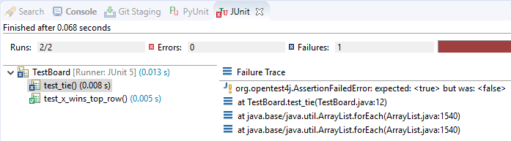
Unit Tests
class TestBoard {
@Test
void test_tie() {
Board board = new Board();
board.setToken(0,Token.X);
// MORE HERE
assertTrue(board.getStatus()==Status.TIE);
}
@Test
void test_x_wins_top_row() {
Board board = new Board();
board.setToken(0,Token.X);
board.setToken(1,Token.X);
board.setToken(2,Token.X);
assertTrue(board.getStatus()==Status.WON_X);
}
}
Java
Board board = new Board();
board.setToken(0, Token.X);
board.setToken(3, Token.O);
board.setToken(1, Token.X);
board.setToken(4, Token.O);
board.setToken(2, Token.X);
Status stat = board.getStatus();
System.out.println(stat);
Java

Slide 15
Player
import java.util.Scanner;
public class HumanPlayer {
Scanner in = new Scanner(System.in);
public HumanPlayer() {
// Maybe a name attribute?
}
public int getMove(Board board, Token token) {
board.print();
System.out.println("Your move player "+token);
int ret = in.nextInt();
// @todo error check and loop back
return ret;
}
}
Java

Slide 16
Types of Players
Board board = new Board();
HumanPlayer player1 = new HumanPlayer();
HumanPlayer player2 = new HumanPlayer();
//MrRandom player2 = new MrRandom();
// Who cares what player1 and player2 are?
// As long as they have "getMove" ...
// No way to say "player2 can be HumanPlayer OR MrRandom".
// We must pick a single type for variable "player2"
while(true) {
int move = player1.getMove(board, Token.X);
board.setToken(move, Token.X);
move = player2.getMove(board, Token.O);
board.setToken(move, Token.O);
}
Java
I don’t care what type this object is. I just care that it has a “getMove” method.
I don’t care what the method does. All I care about is the name.
And arguments.

Slide 17
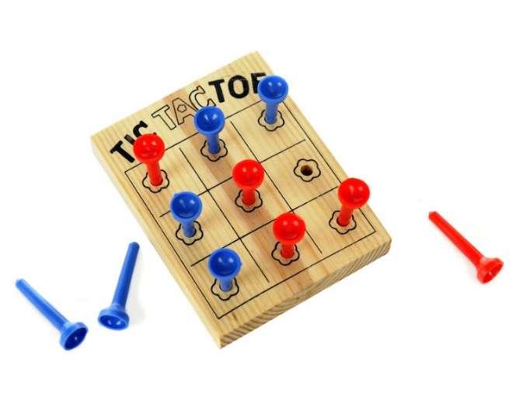
Tinkering
Make a program that plays four games at once.
Create 3 players to participate in the four games. Let them be ‘X’ in some games and ‘O’ in others.
Prompt the players one at a time for their move.

